Slide 1
Getting Started with AngularJS as a .NET Developer
Jake Adams
@jacobladams
Link Bundle http://bit.ly/jakeangular

Slide 2




































Platinum Sponsors
Gold Sponsors
Silver Sponsors

Slide 3
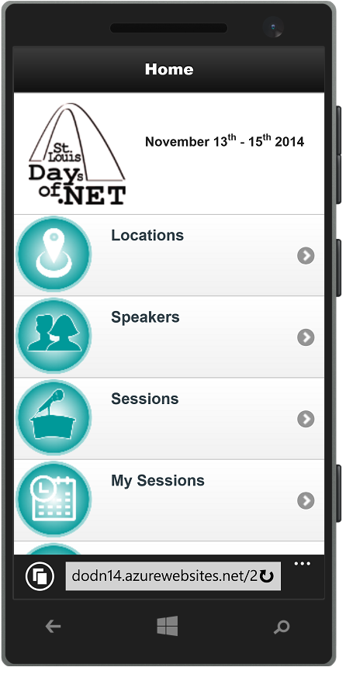
Conference Mobile App
dodn14.azurewebsites.net
Quick access to conference info
Build your custom agenda
Anonymously rate the sessions you attended
Share with the Twitter-verse

Slide 4




Fun Stuff Downstairs

Slide 5
About Me
Jake Adams
Software Architect
Thompson Coburn LLP
Email: jacobladams@gmail.com
Twitter: @jacobladams
geekswithblogs.com/jacobladams
github.com/jacobladams
Bit.ly bundle of links for this presentation - http://bit.ly/jakeangular

Slide 6

What is AngularJS?
JavaScript MVW (Model–View-Whatever) framework
HTML enhanced for web apps
Framework for building web applications in JavaScript and HTML

Slide 7


Slide 8

Why
Angular is a:
Client Side
JavaScript
Framework
For Building Web Applications

Slide 9
Why
Makes the web work the way you want, not vice versa
Uses best practices from server side technologies, including
Modularity,
Testability,
Dependency injection

Slide 10

Things to Consider
Full framework
Lots of functionality, but lots to learn.

Slide 11

Things to Consider
Working with other libraries and frameworks….

Slide 12
GIVE MEH TEH CODEZ!

Slide 13
Debugging
Visual Studio / IE
Know Your Dev Tools
Batarang / NG Inspector

Slide 14
Testing
Karma
Protractor

Slide 15
Further Learning
Pluralsight
Code School
Adventures in Angular

Slide 16
Jake Adams
Software Architect
Thompson Coburn LLP
Email: jacobladams@gmail.com
Twitter: @jacobladams
geekswithblogs.com/jacobladams
github.com/jacobladams
Bit.ly bundle of links for this presentation - http://bit.ly/jakeangular

